Slide 1

Phase 1 Presentation
Team 4

Slide 2

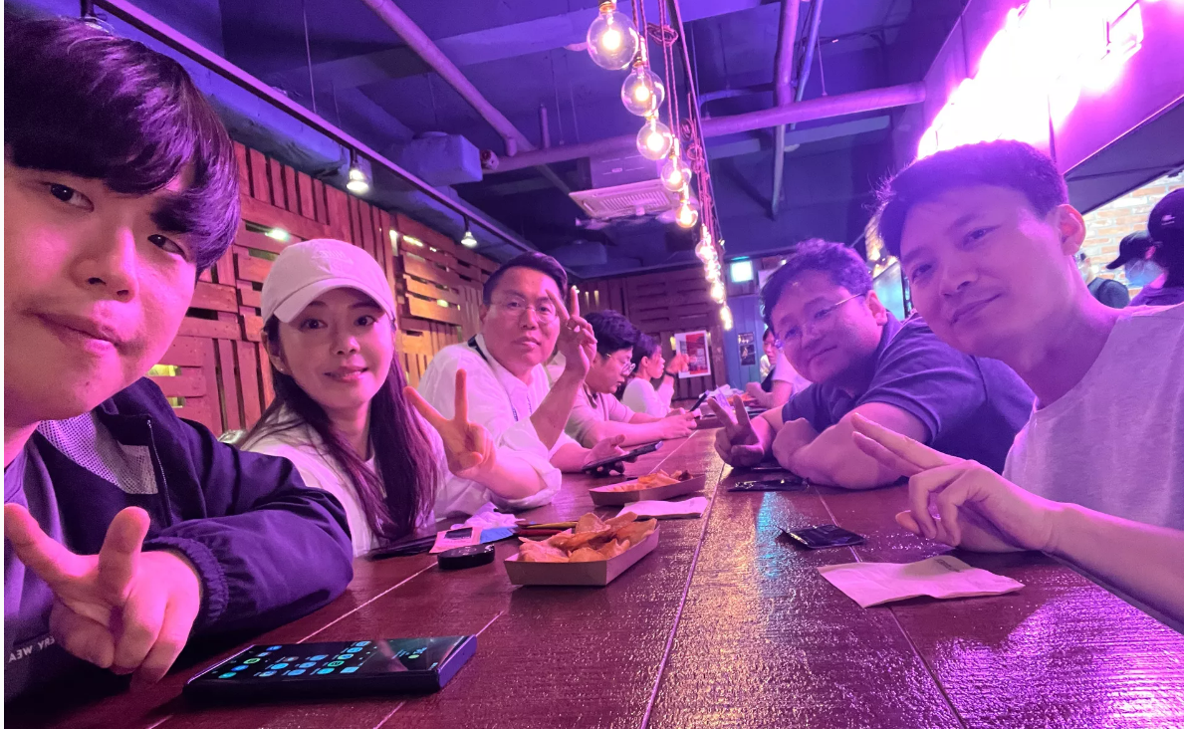
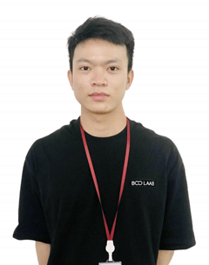
Team introduction
Developer (Backend)
Truong Quang Viet
Our Wonderful Mentor
Clifford
TEAM Name : B1C2V3 1 member from BS company 2 members from CTO 3 members from VS company
Developer (App)
Hongjae Lim
Developer (App)
Minji Tae
Requirement & Test Manager
Youngjin Kim
Threat Analyst & Architect
Chanhun Seung
Team leader
Jongoh Ha

Slide 3
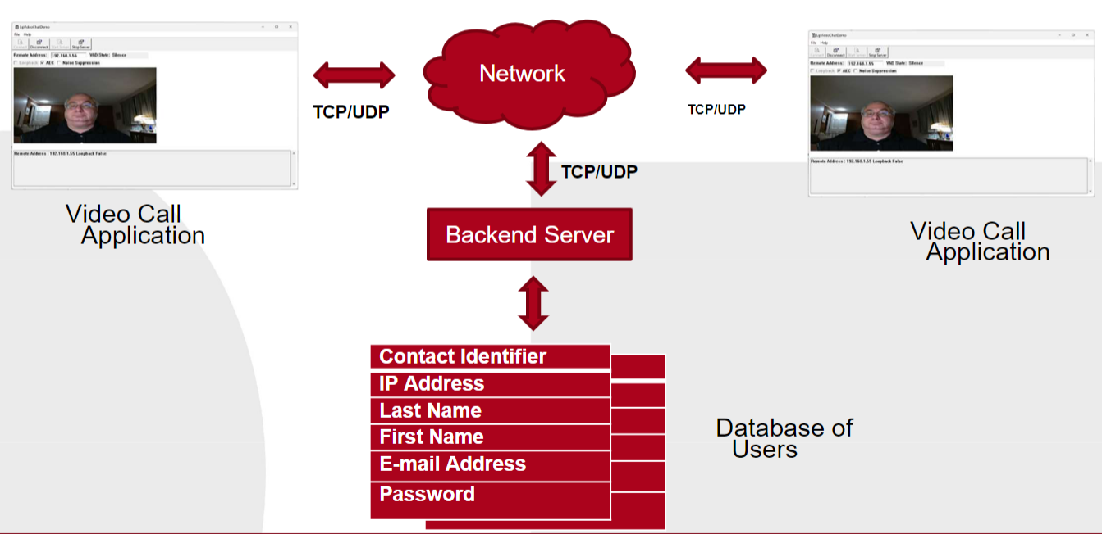
Project Overview
System overview
Video Call Application for both business and personal users
Video Call Communication over the Network
User registration and login function with two factor authentication
Current design needs to be improved in terms of security

Slide 4
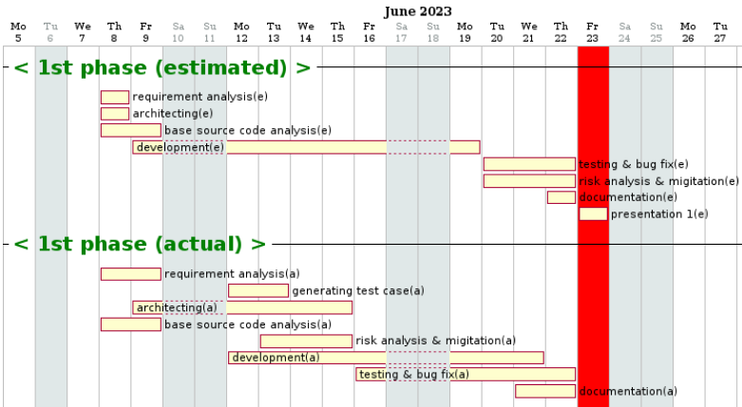
Project Plan & Schedule
Requirement Analysis
Initial design &
Code analysis
Generating test cases
Risk analysis & Mitigation
Improving Design
Verification & Bug fix
Documentation
Presentation
Development

Slide 5
Requirement Analysis
Functional Requirement | New user registration | 11
 | Login | 8
 | User email update | 8
 | Periodic password reset | 10
 | Lockout due to incorrect password | 13
 | Reset password | 7
 | Unique ID | 1
 | Contact list | 2
 | Call | 4
 | Connection | 2
 | Notice | 2
 | Disconnect | 2
 | Activation | 1
 | Communication method | 1
Non Functional Requirement | Performance | 1
 | Authentication | 2
 | Communication privacy | 1
 | Non repudiation | 1
 | Reliability | 1
Total |  | 78
Number of Initial requirements : 19 (functional : 14, non functional : 5)
Analyzed initial requirement in team workshop and mentor meeting
Requirement manager derived 78 system requirements through additional analysis

Slide 6
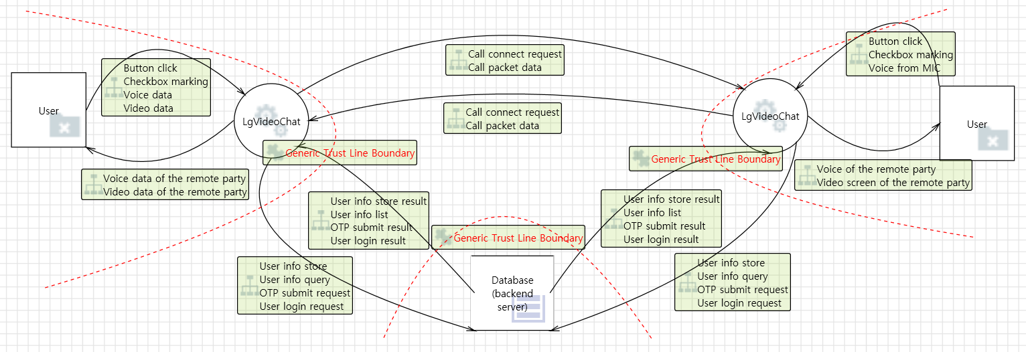
Initial Design (Overall System)
Initial Design reflecting all system entities and communication data

Slide 7
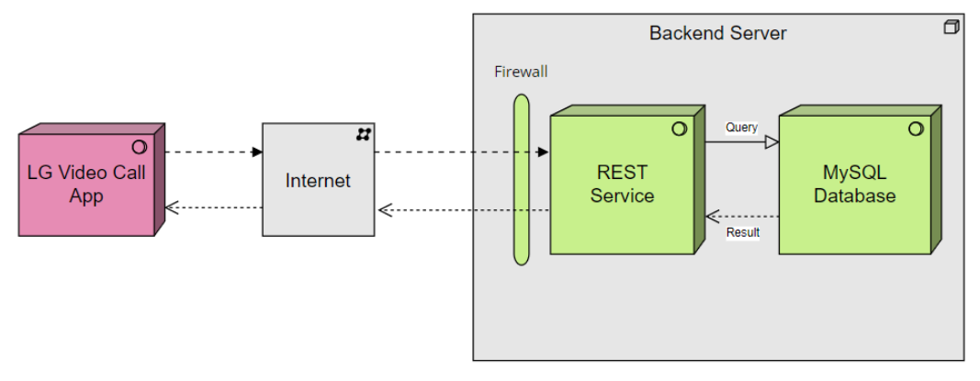
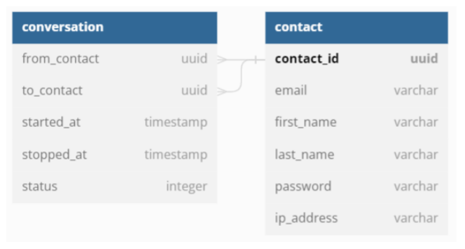
Initial Design (Backend server)
Initial Design for backend server

Slide 8
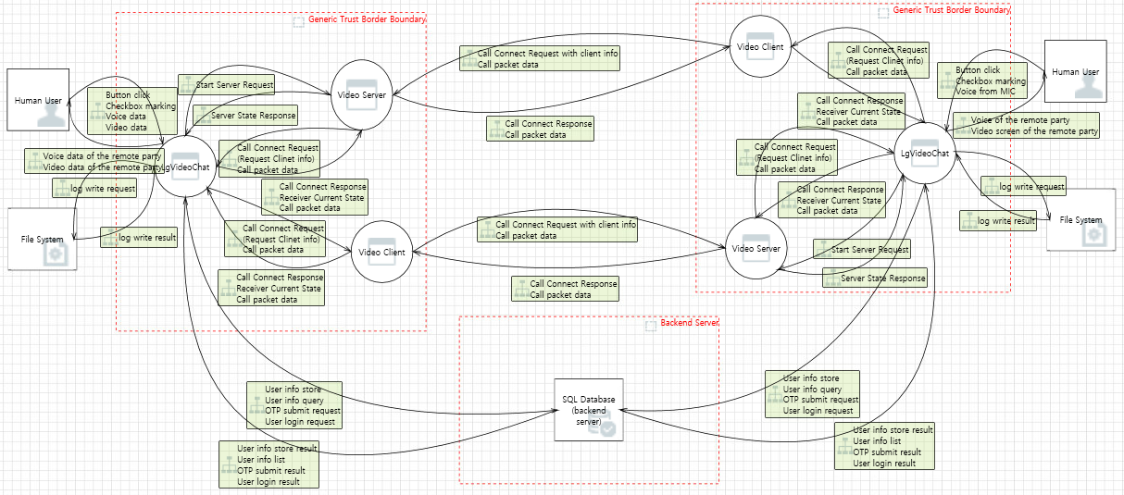
Threat Analysis
DFD and STRIDE methodology was used to perform Threat Analysis

Slide 9
Security Requirements & Mitigations
Number of Identified threats : 45
Prioritized each threat through team workshop
Resulted in various score : 4, 6, 8, 10
Key Security Requirements from high priority threats (Score 6, 8, 10) are as follows
1. PKI-based server authentication for App and Backend Server 2. Secure communication between Apps 3. Secure communication between App and Backend Server 4. Two factor authentication using password and OTP to email => Initial requirement has been specified in detail 5. Input validation check by Backend Server 6. Storing log file by App and Backend server

Slide 10







Overall System Design for Security Requirements
VideoChat app
VideoChat app
Call packet data Call Connection/Disconnection request
User
Storing log file
Storing log file
User registration request/response User login request/response
Contact info query/response
User registration request/response User login request/response
Contact info query/response
Backend Server
Storing log file
System entity
encryption
input
validation
data
flow
two factor authentication
hash
certificate
file system

Slide 11
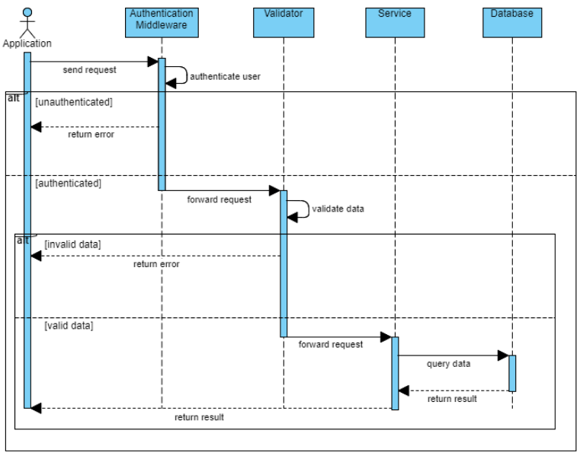
Sequence Diagram for Secure design (1)
Input Validation Check by Backend Server

Slide 12
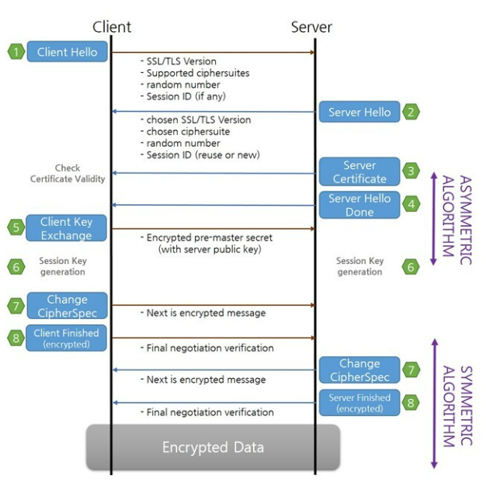
Sequence Diagram for Secure design (2)
PKI-based server authentication for both Application and Backend Server
Secure communication between Applications
Secure communication between Application and Backend Server
Adopted Solution : TLS v1.3

Slide 13
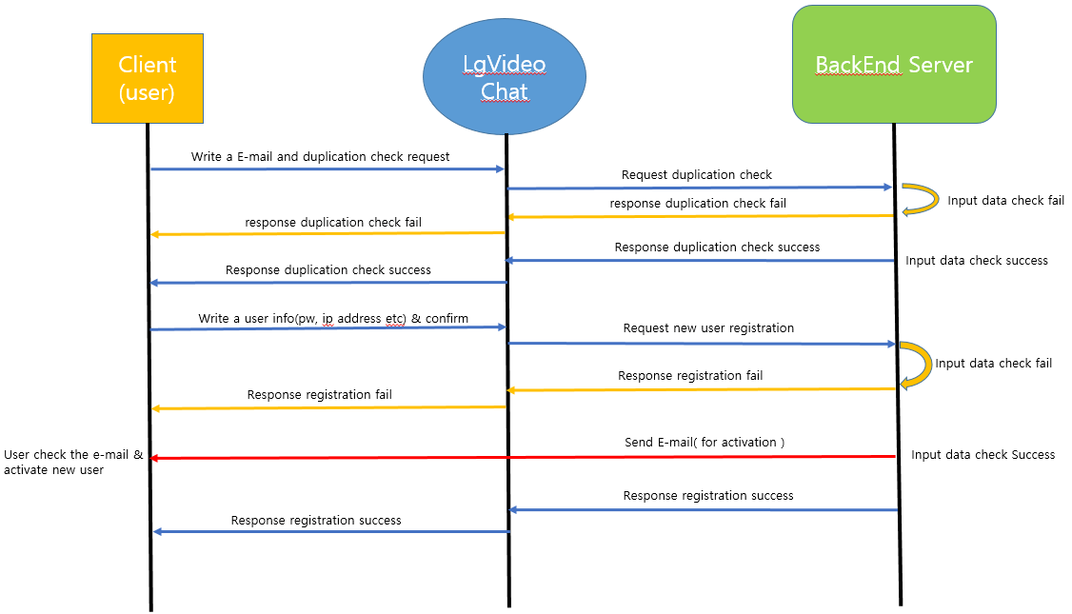
Sequence Diagram for Secure design (3)
Two factor authentication (User registration)

Slide 14
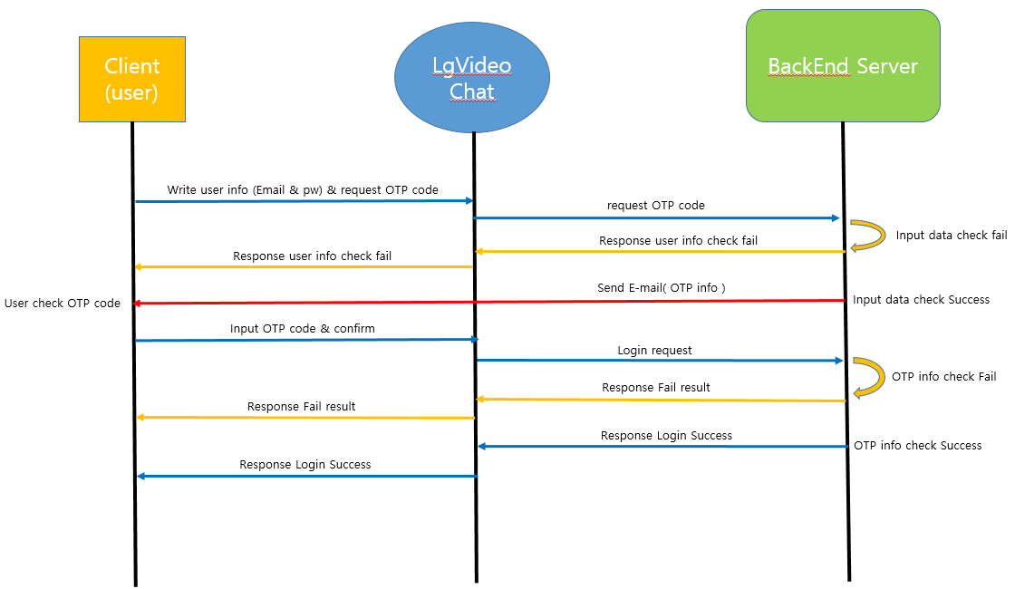
Sequence Diagram for Secure design (4)
Two factor authentication (User login)

Slide 15
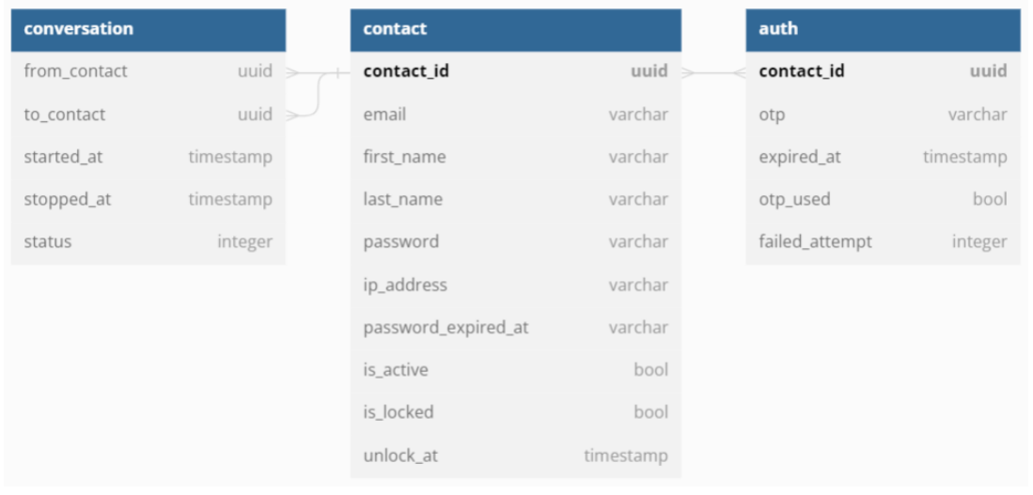
Database table for Secure design
Change in database table design for two factor authentication

Slide 16
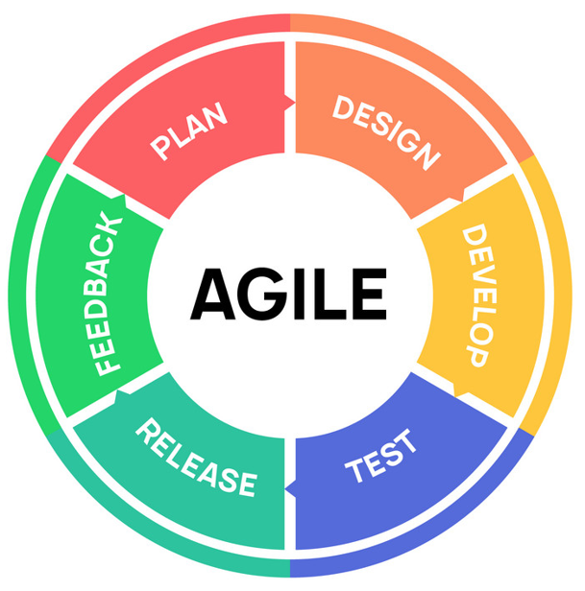







Implementation
Agile methodology was applied. The reason and how … - Started implementation before completing all design due to lack of time - Need to reflect changed and added system design after threat analysis - Development and Verification was performed in parallel to find bugs earlier - Sync up meeting and sharing obstacles every day (http://collab.lge.com/main/display/SCSPECIALT/0.+Meeting+Minute)
Development environment and tools - Visual Studio Community, Beyond compare - MySQL, Ethereal for Fake Email Service - Self signed certificate for server authentication - GitHub for sharing and integrating source code - Additional library : Openssl, Boost, Nlohmann-json for application

Slide 17
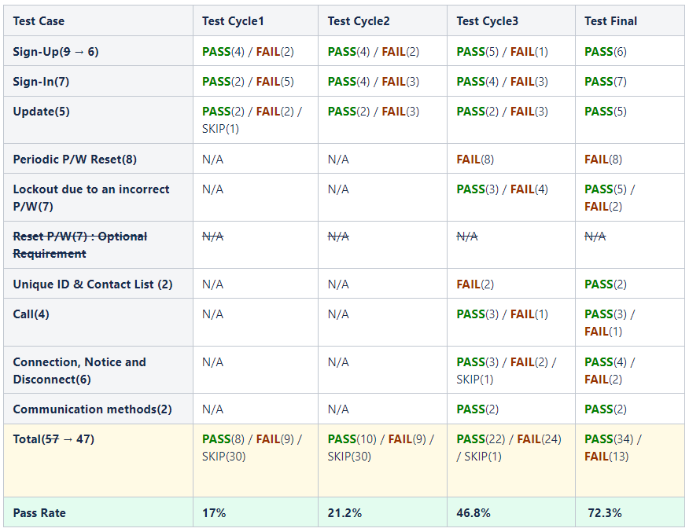
Verification
Test case Generated based on Functional requirements
Test purpose - To verify initial functional requirements - To verify additional security requirements
Test constraints - Use Ethereal site for Fake email service - Laptops testing the application should be connected through router - Firewall configuration in Laptop should be disabled
Final test result - Total test cases : 47 - Pass : 34, Fail : 13 (not critical issues) - Pass rate : 72.3%

Slide 18
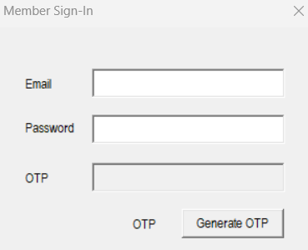
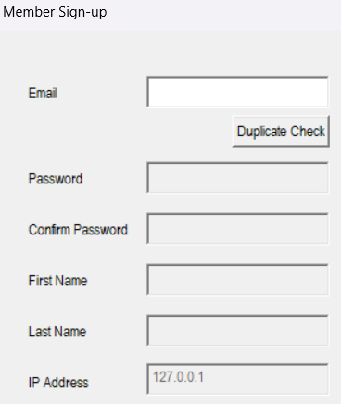
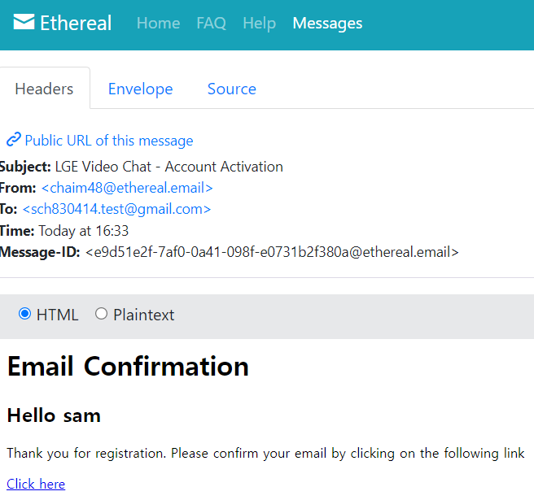
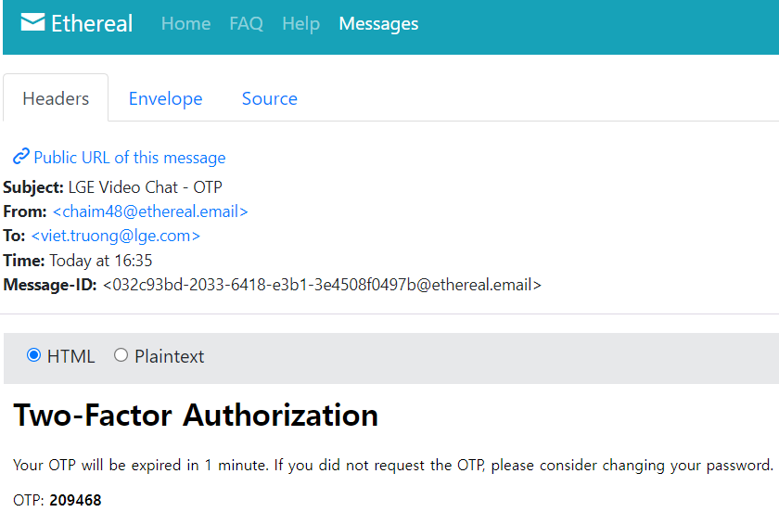
Verification
Two factor authentication

Slide 19
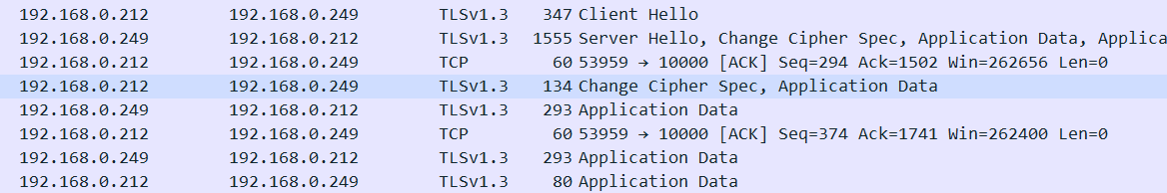
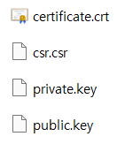
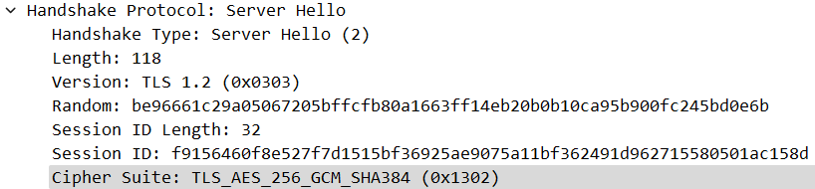
Verification
Server Authentication & Secure communication
Self signed certificate

Slide 20
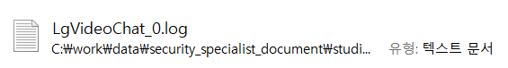
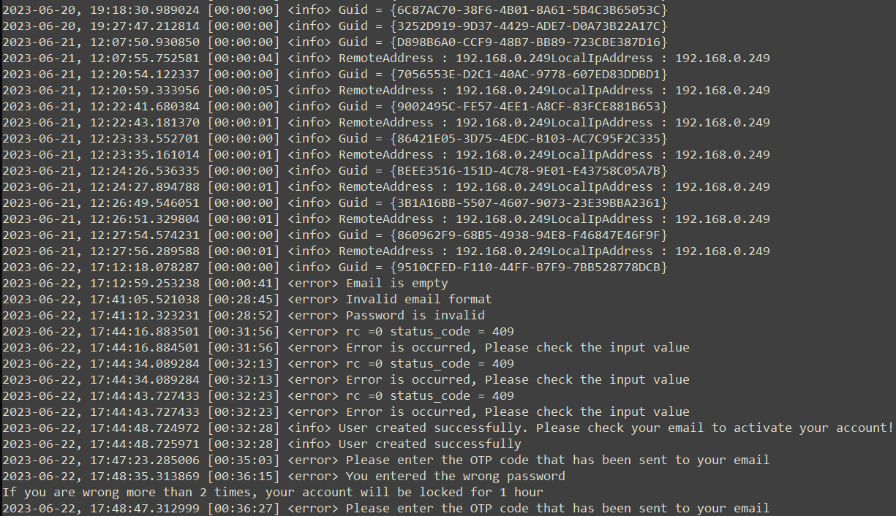
Verification
Storing log file to the file system

Slide 21
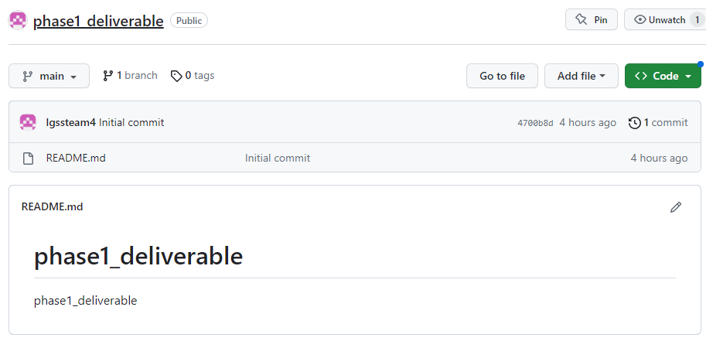
Deliverables
Following materials will be uploaded to Github - Requirement - System Design and Sequence diagram - Developer guide to build the software - User guide to run the software - Final source code
https://github.com/lgssteam4/phase1_deliverable

Slide 22

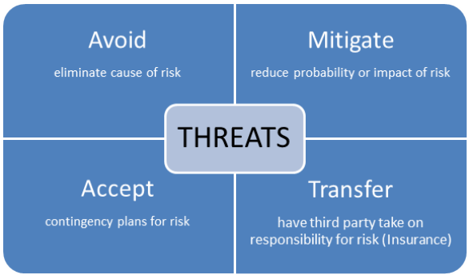

Lessons Learned
Project Plan from Security Perspective - Our team could understand overall process for the project which has to consider security - To catch up the unexpected needs, our team changed the initial schedule and order
Threat Analysis & Secure Design - Our team was able to realize the importance of threat analysis for secure design - Applying only given requirement by customer can be very dangerous from security perspective - The more we learn and experience on security, the more we could find the threats and mitigations
Secure Implementation - Using open source libraries were essential for our implementation - Not only secure coding but also managing vulnerabilities in the 3rd party libraries will be very important for secure implementation

Slide 23

Q&A
Email Contact for Additional Questions and Incident Response : ss-team4@lge.com

